Slide 1

CYBER SECURITY

Slide 2
To understand
What is the meaning of the word CYBER .
What is the need of CYBER SECURITY .
What are the security problem on CYBER field .

Slide 3

Introduction
The term cyber security is used to refer to the security offered through on-line service to protect your online information .

Slide 4

Meaning of the word cyber
It is a combining form relating to information technology , the internet , and virtual reality .

Slide 5
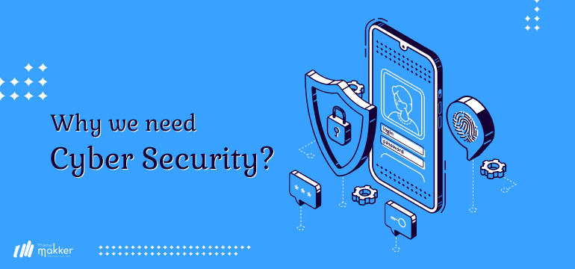
Need of cyber security
Cyber security is necessary since it help in securing data from threats such as data threats such as data theft or misuse , also safeguards your system from viruses.

Slide 6
Major security problems
Virus
Hacker
Password cracking

Slide 7

Viruses
A virus is a program that is loaded into your computer without your knowledge and runs against your wishes .

Slide 8

Solution
Install a security suite that protects the computer against threats such as viruses .

Slide 9

Hackers
In common a hacker is a person who breaks into computer , usually by gaining access to administrative controls .

Slide 10
How to prevent hacking
It may be impossible to prevent computer hacking however effective security controls including strong passwords , and the use of firewalls can helps

Slide 11
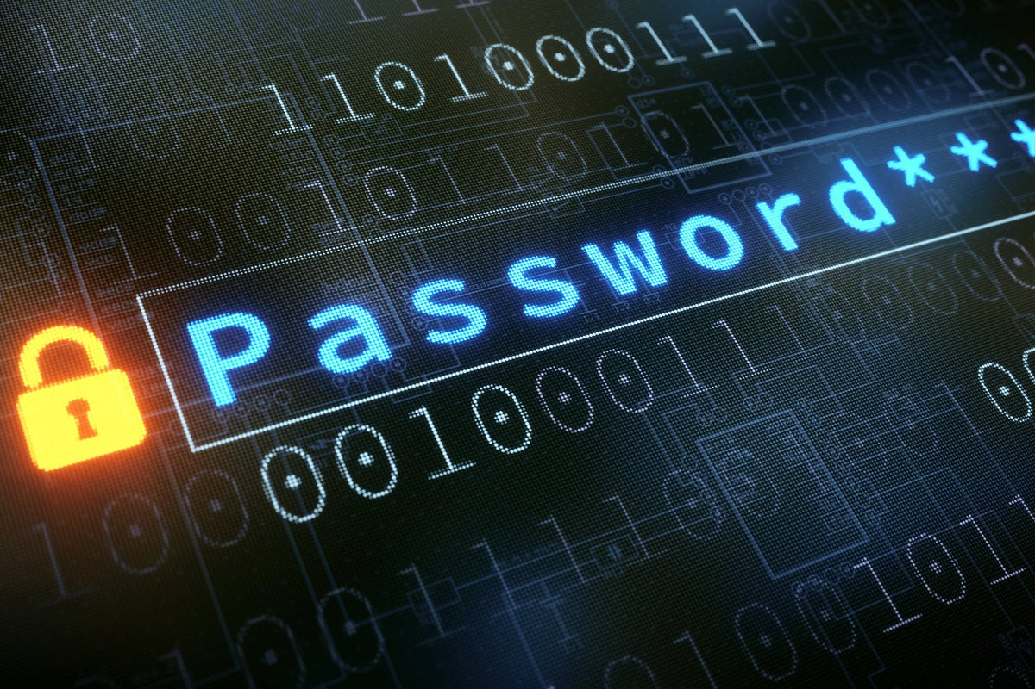
Password cracking
Password attacks are attacks by hackers that are able to determine password or find password to different protected electronic area and social network sites .

Slide 12
Securing password
Use always strong passwords .
Never use same password for two different sites .

Slide 13

ANTIVIRUS

Slide 14
What is Anti-virus
Antivirus or anti-virus software (often abbreviated as AV),sometimes knows as anti-malware software, is computer software used to prevent, detect and remove malicious software.
Antivirus Software was originally developed to detect and remove computer viruses.

Slide 15
ANTIVIRUS SOFTWARE
Antivirus software identifies, prevents, and removes malware from a computer system.
Malware is any number of viruses and software bits that intend to harm the computer or steal information such as viruses, adware, backdoors and worms.

Slide 16

Types Of Antivirus Software
Free Antivirus Software
Paid Antivirus Software
Examples :
Avira
Bitdefender
Avast
AVG
Microsoft Defender
Examples :
Norton 360
McAfee
Kaspersky
ESET
Webroot

Slide 17
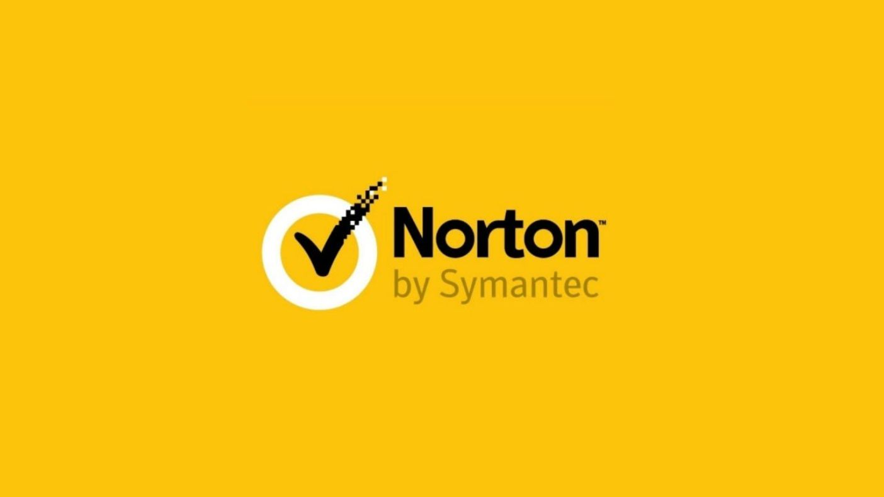



Popular Antivirus Software
Norton 360
AVG
Paid
Free
Avast
McAfee
Free
Paid

Slide 18

Advantages Of Antivirus Software :
Protection from Malware.
Protection from Viruses.
Protection from Spyware and Identity Theft.
Protection from Spam.
Protection of computer files.
Customizable Firewalls.
Real Time Protection.
Protects from Harmful Web Activity.

Slide 19

Disadvantages Of Antivirus Software :
System Slowdown
No Complete Protection
Security Holes
Limited Detection Techniques
Frequent Advertisements
No Customer Support

Slide 20
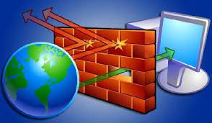
Firewall Software
Analyzes incoming and outgoing data packets on a network; that is all the information sent and received through the computer’s network connection.

Slide 21
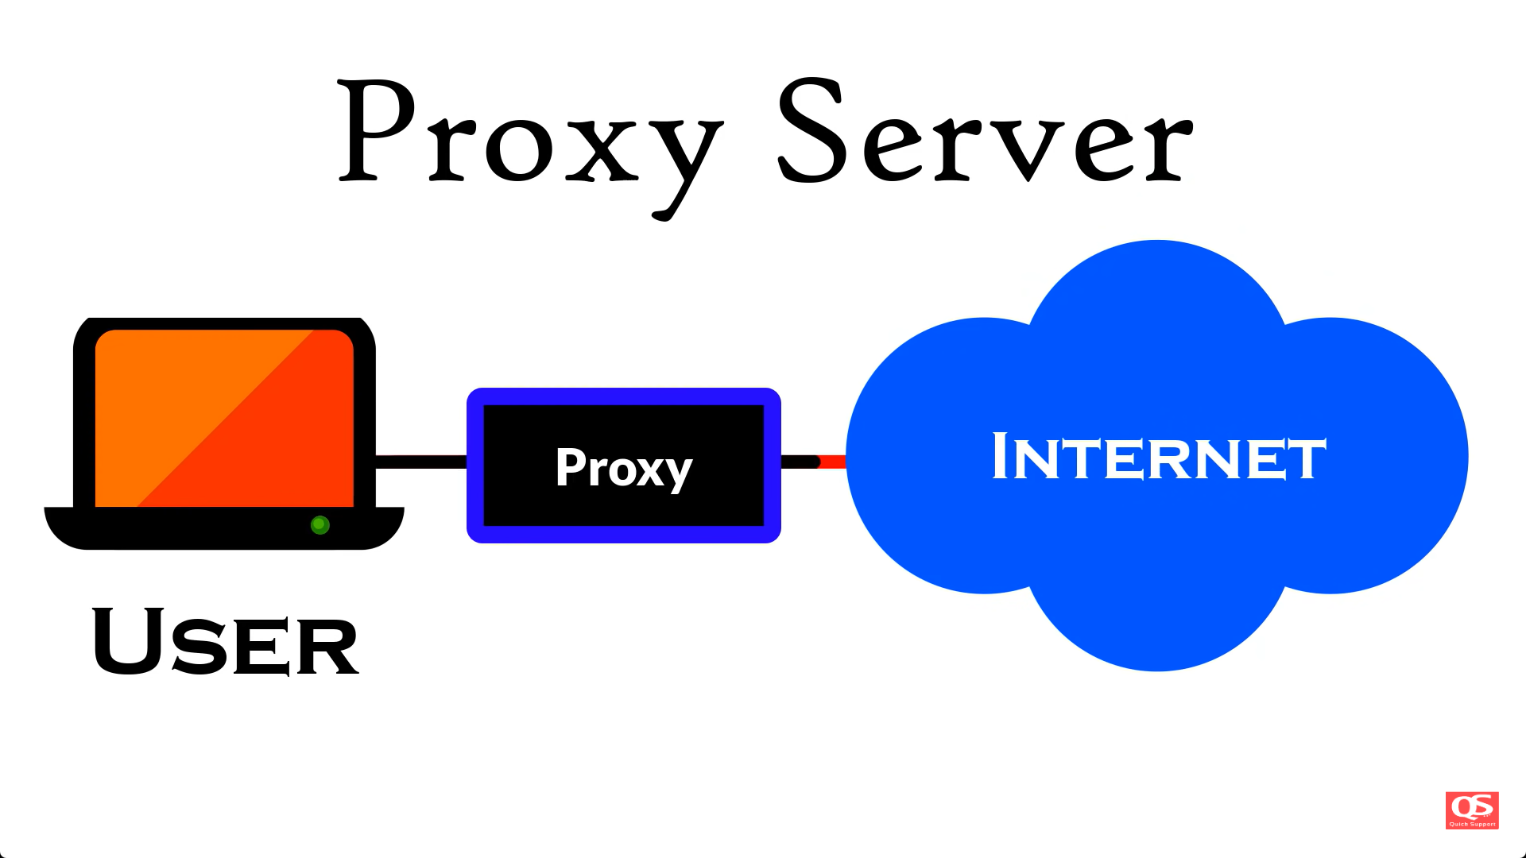
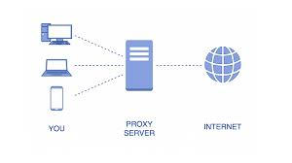
PROXY SERVERS
Proxy server act as a firewall in that they inspect incoming packets for specific applications and block all other requests.

Slide 22

Cryptography

Slide 23
Cryptography
The word cryptography in Greek means “secret writing ’’ .
cryptography is the science and art of transforming message to make them secure and immune to attack .

Slide 24
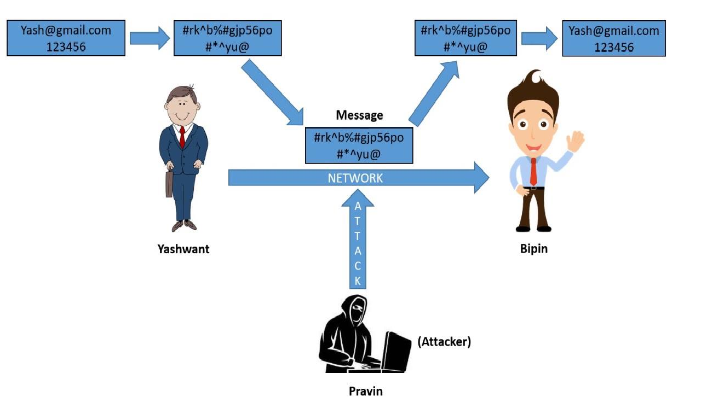

Slide 25
Types of cryptography
ENCRYPTION CRYPTOGRAPHY
DECRYPTION CRYPTOGRAPHY

Slide 26
ENCRYPTION & DECRYPTION CRYPTOGRAPHY
Encryption cryptography :-
An encryption cryptography transforms the plain text to cipher text .
Decryption cryptography :-
A decryption cryptography transforms the cipher text back to plain text .

Slide 27
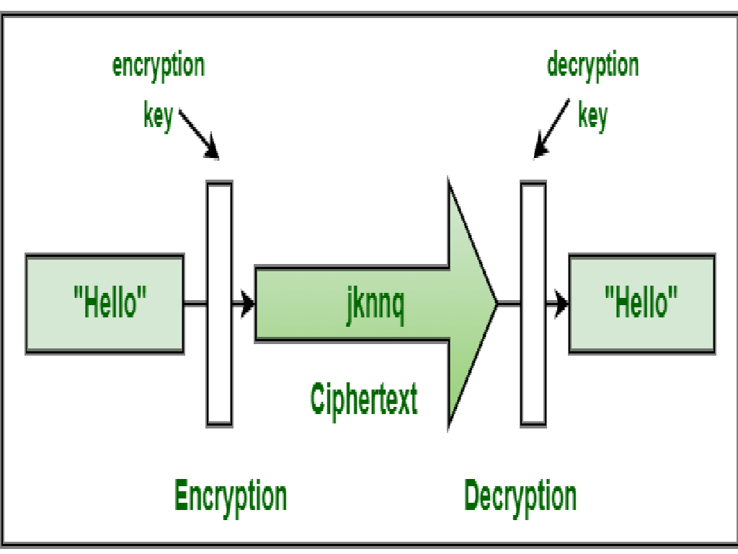

Slide 28
PLAIN TEXT & CIPHER TEXT
Plain text : The original message , before transformed is called plain text .
Cipher text : After the message transformed , is called cipher text .
PLAIN TEXT
CIPHER TEXT
ENCRYPTION

Slide 29
THANK YOU

